Slide 1
Unconventional R

Slide 2
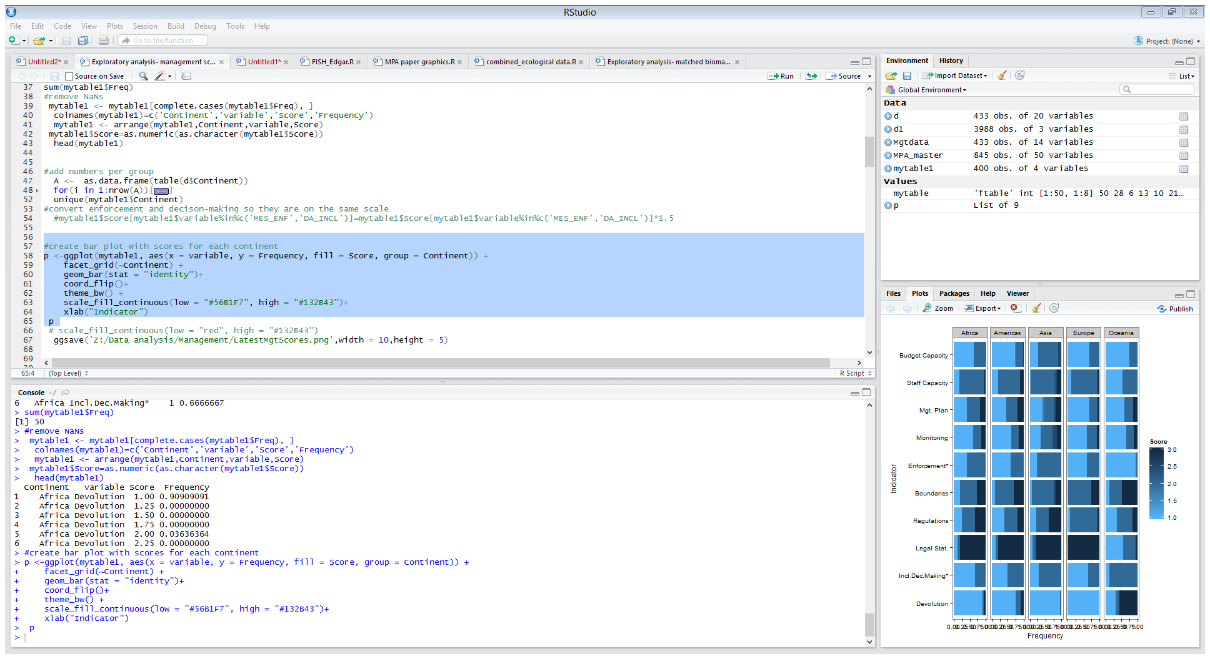

Slide 3
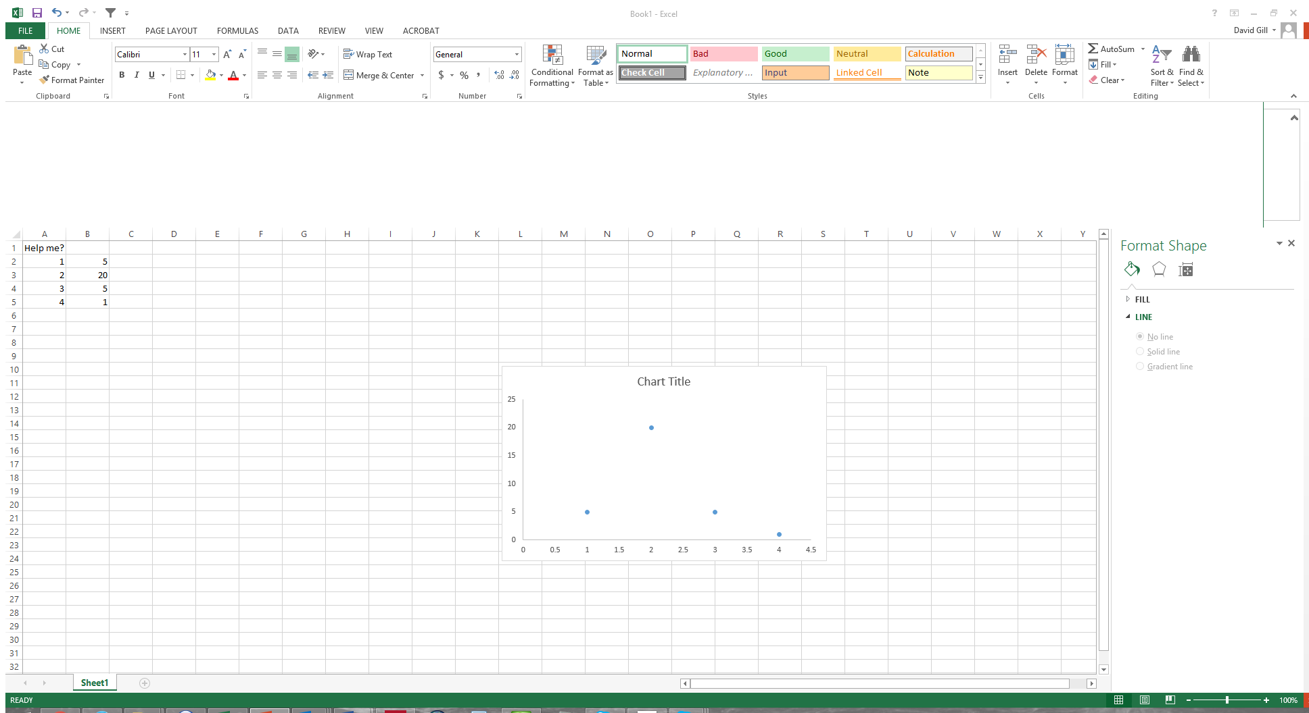

Slide 4
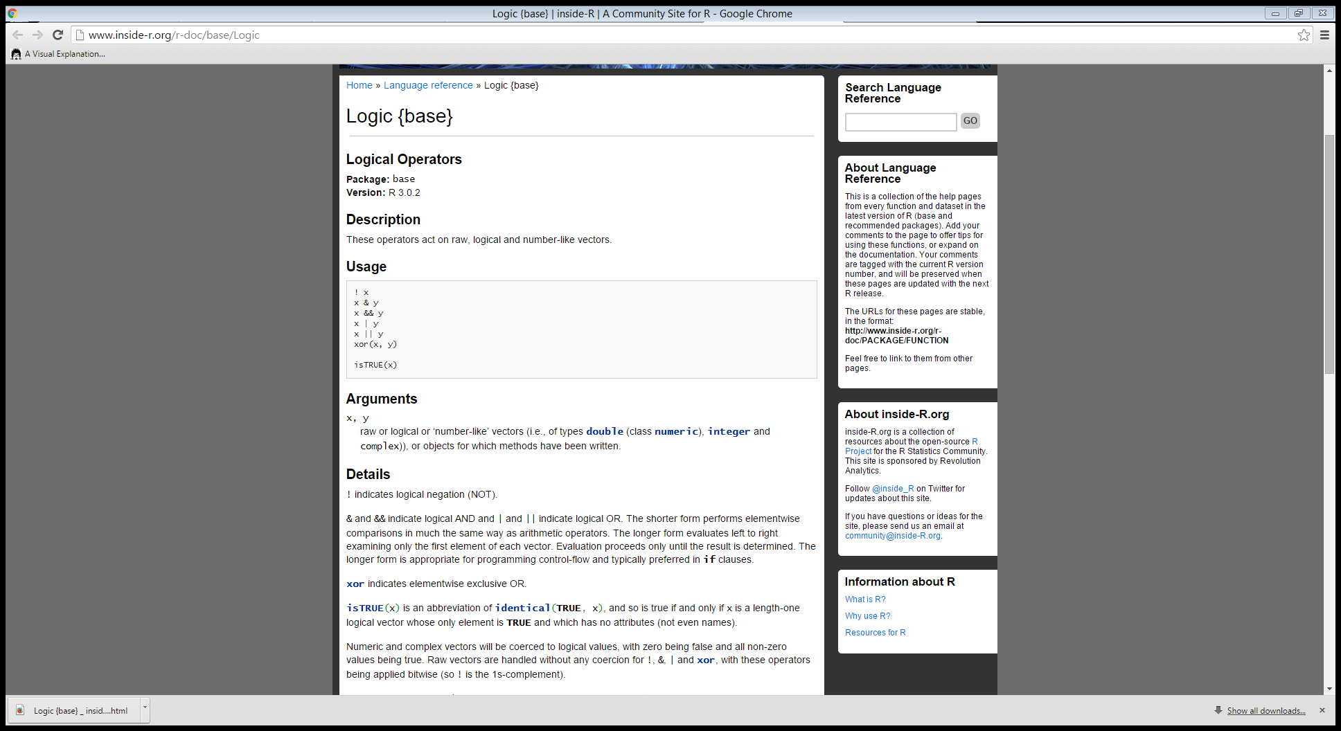

Slide 5
How I learned R
Unashamedly, intentionally, prolifically steal R code
Build your own cheat sheet
Find great online resources (and friends) to get more code from
Hybrid work structure (incremental transition to R)

Slide 6
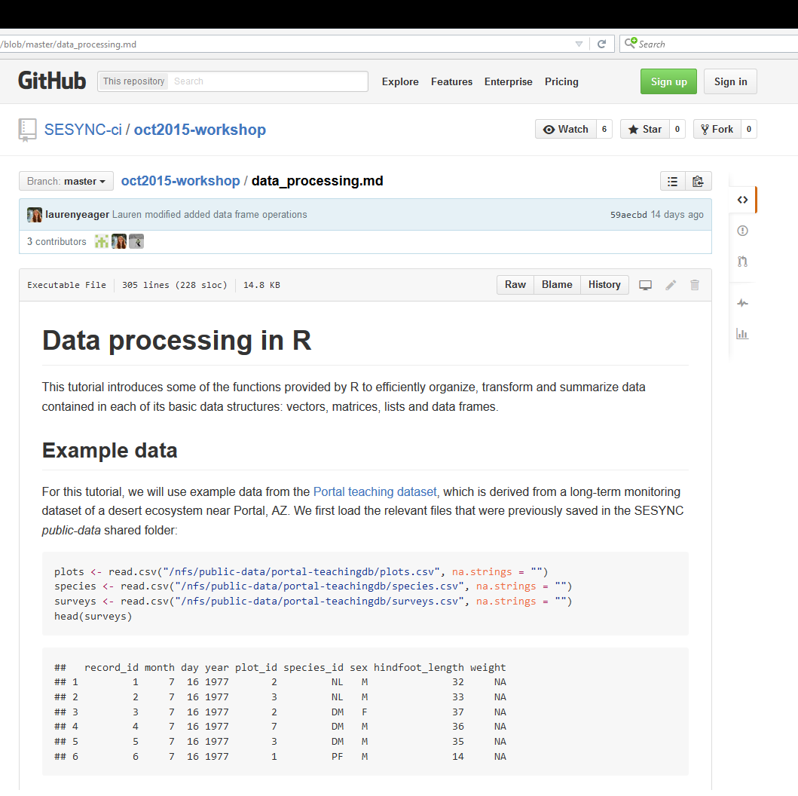
Unashamedly, intentionally, prolifically steal R code
Great resources
July CSI workshop
October CSI workshop

Slide 7
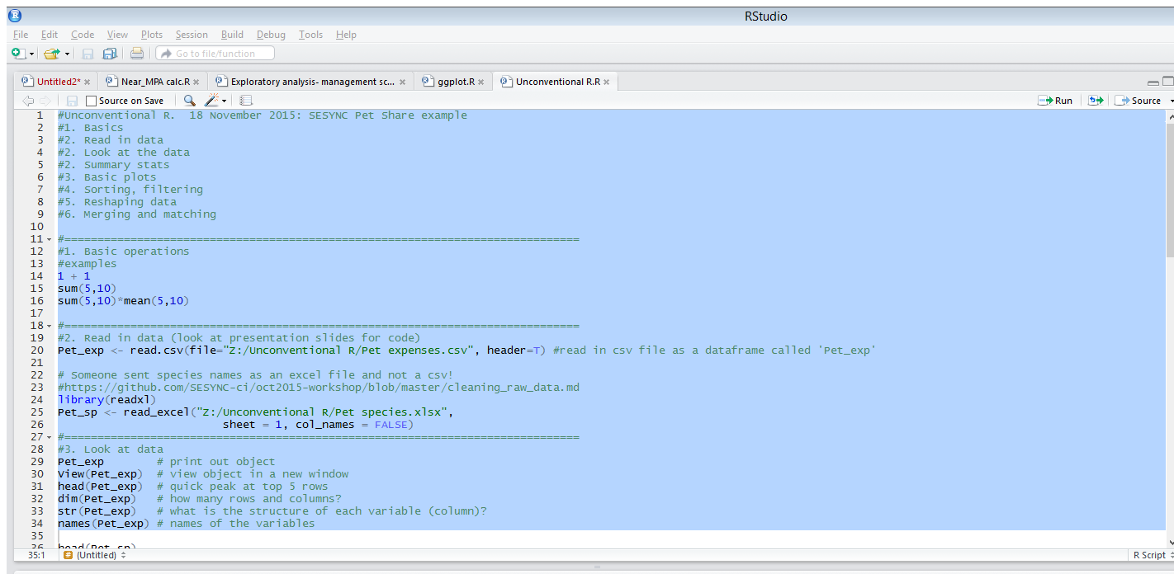
2. Build your own cheat sheet
Build your own cheat-sheet
Compile relevant code
Annotate!

Slide 8
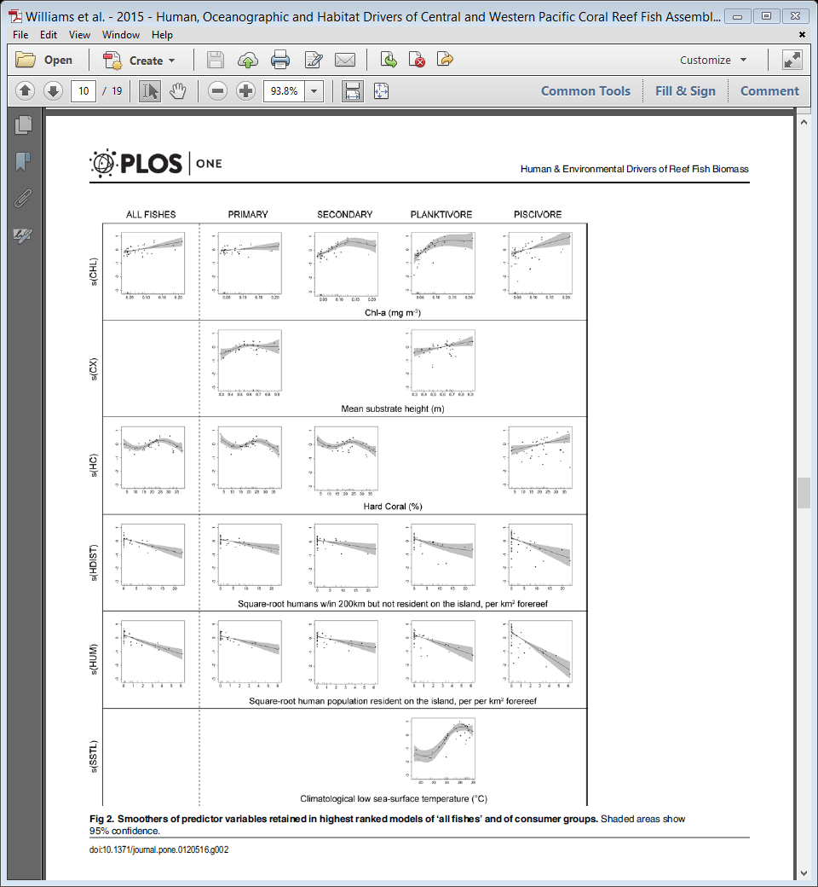
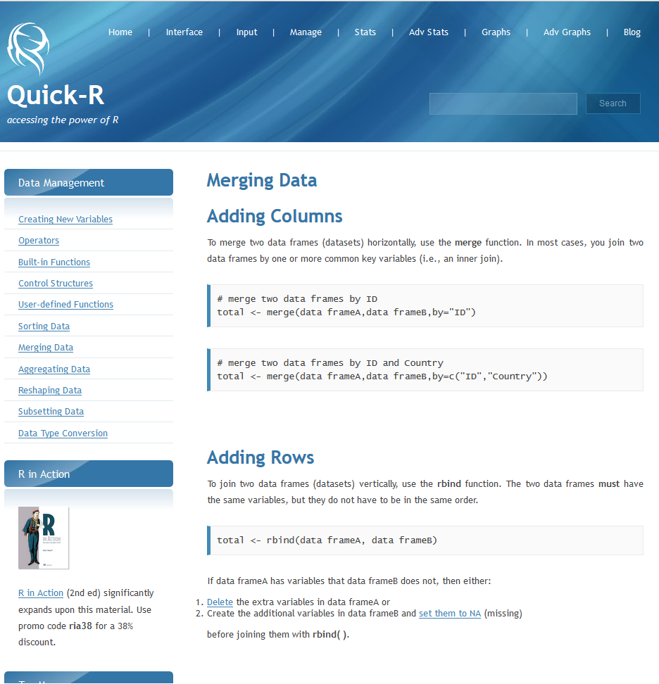
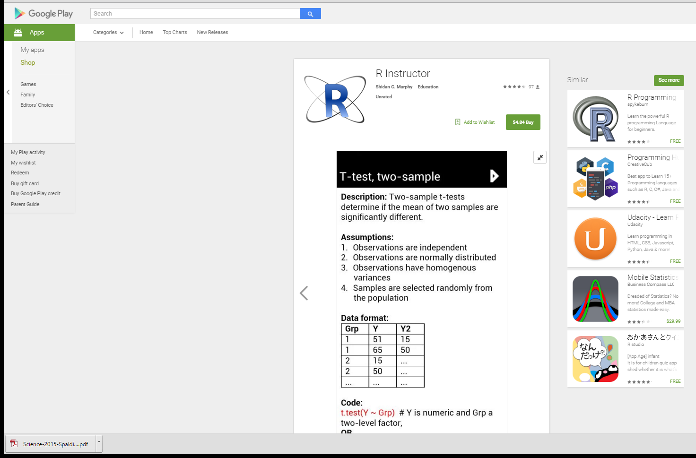
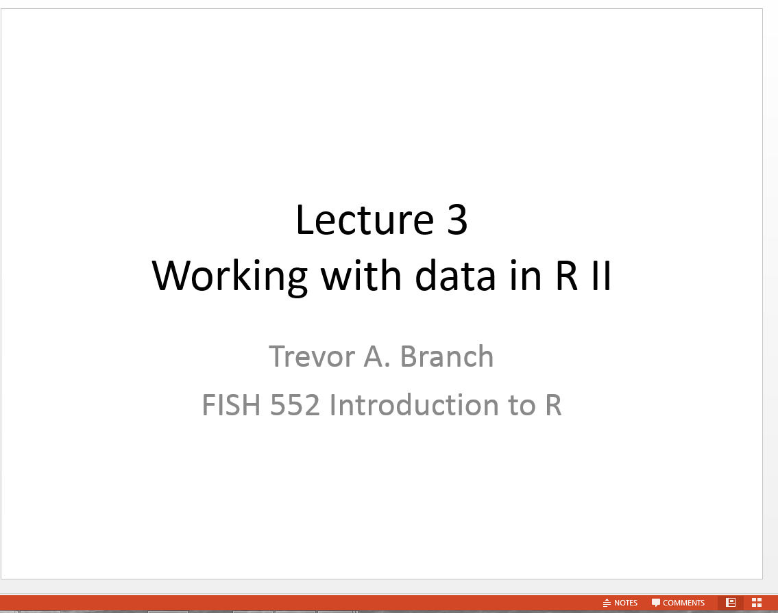
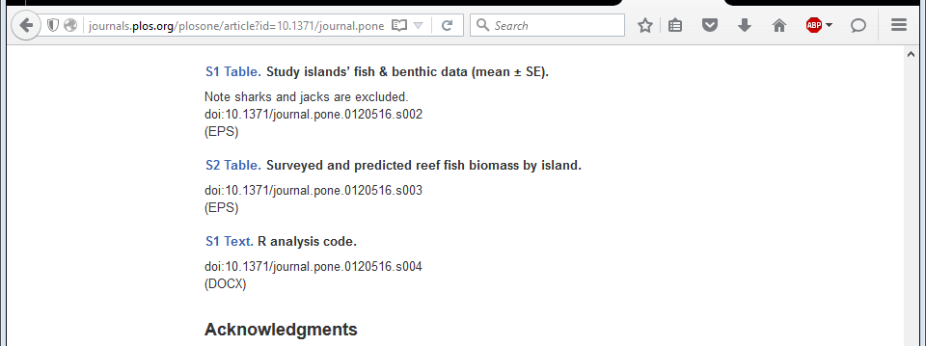
3. Find great online resources (and friends) to get more code
Tutorial websites
Quick-R
R Lecturers
Trevor Branch lectures
Supplementary material
Smartphone apps?
Add to your personal cheat sheet/s (and annotate)

Slide 9
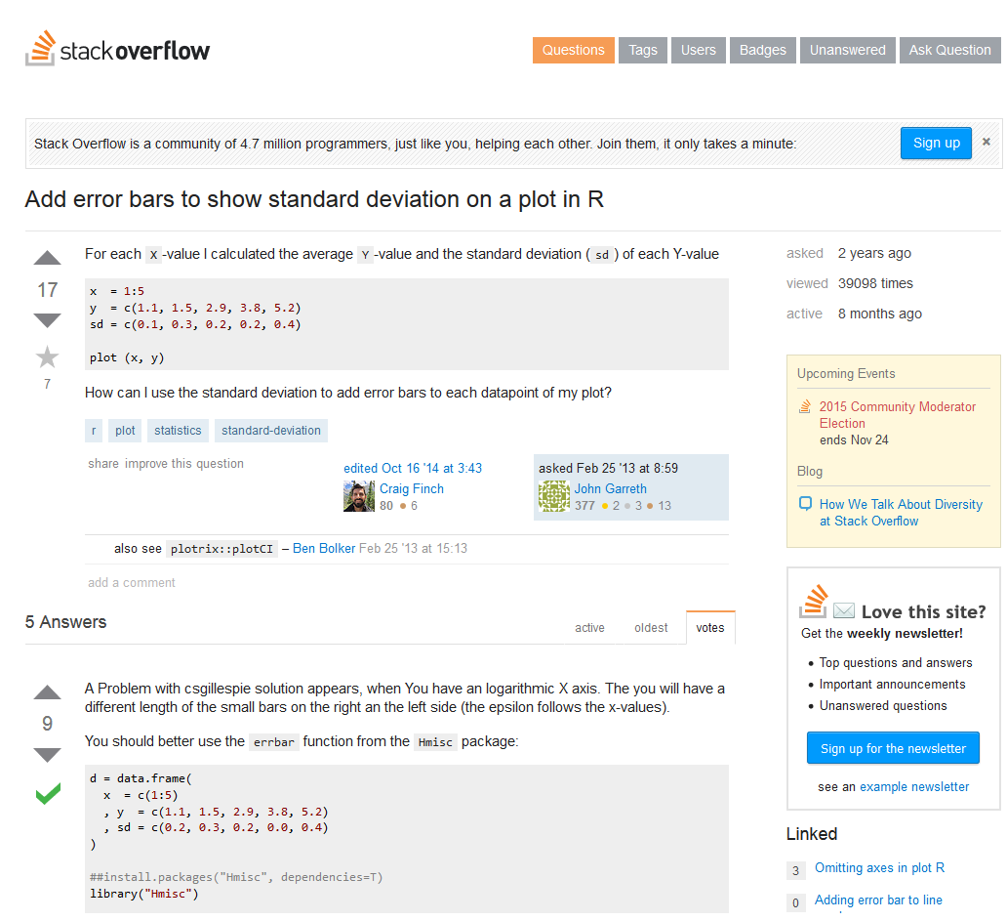
3. Find great online resources (and friends) to get more code from
These sites are sometimes a bit of a learning curve

Slide 11




©Trevor Branch
Boolean logic (T or F)
rain and snow
rain
snow
I carry an umbrella if it both rains and snows on the same day
I carry an umbrella whenever it rains or snows
I carry an umbrella for rain but never for snow
I never carry an umbrella for rain, only for snow
rain or snow
rain and (not snow)
(not rain) and snow

Slide 12
©Trevor Branch
rain and snow
rain & snow
rain
snow
rain or snow
rain | snow
rain and (not snow)
rain & !snow
(not rain) and snow
!rain & snow

Slide 13
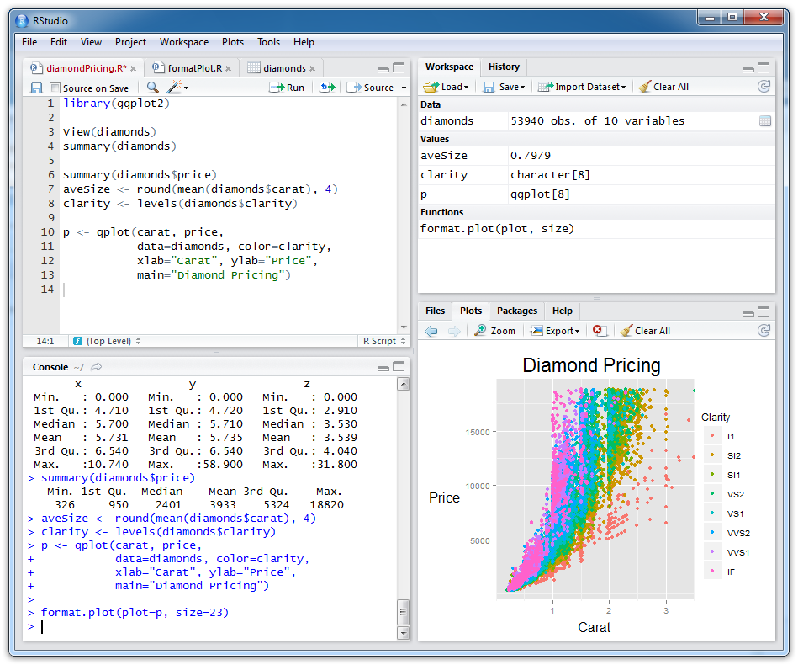
©Trevor Branch
Scripts (files
with R code)
Objects you have created
Plots and help
R console (results from
running R code)

Slide 14
Example: SESYNC Pet-share
Read in data
Open both Excel files
Get some summary stats
Mean spending per sitter (bonus: find standard error)
How much did each sitter spend in total?
Basic plots
Create a bar plot of total spending
Is there a correlation between sitter spending? (bonus: add axis and main titles)
Add regression line
Sorting, filtering
Re-order the data by pet?
Filter the data to see how much one sitter spent on each
Reshaping data
Get mean spending per pet
Get mean spending per pet per sitter
Merging and matching
Did SESYNC sitters spend more on cats or dogs?
(bonus) Is difference significant?

Slide 15
Reading in as text not factors
Example of where to get code
©Trevor Branch
Most often I am using a database where I want the text to be text, and not factors
> x <- read.csv(file="Data/dat_df1.csv", header=T)
> x$sex
[1] M F F M F M M F F M
Levels: F M
> x <- read.csv(file="Data/dat_df1.csv", header=T,
+ stringsAsFactors=F)
> x$sex
[1] "M" "F" "F" "M" "F" "M" "M" "F" "F" "M"

Slide 16
Extracting rows/columns by indices
Example of where to get code
©Trevor Branch
Specify the row index, column index or both
object[row, column]
Extract column 2
> fishData[,2]
[1] 14.8 21.0 19.7 23.2 16.0 16.1 20.0 29.3 17.8 21.2
Exclude column 1, retain columns 2-3
> fishData[,-1]
weight condition
1 14.8 good
2 21.0 fair
3 19.7 fair
...

Slide 17
4. Hybrid work structure (incremental transition to R)
Work between R and Excel till you get comfortable
Alternative approach: Rcmdr

Slide 18

Other resources
NPS
Hadley Wickham

